Slide 1
Introduction to PLD
Chapter2

Slide 2
Programmable Logic Device
A programmable logic device is a device whose logic characteristics can be changed and manipulated or stored through programming.
It has configurable logic and flip-flops linked together with programmable interconnect.
Memory cells control and define the function that the logic performs and how the various logic functions are interconnected.
Though various devices use different architectures, all are based on this fundamental idea.
The major programmable logic architecture available today are:
Simple Programmable Logic Devices (SPLDs),
Complex Programmable Logic Devices (CPLDs), and
Field Programmable Gate Arrays (FPGAs)

Slide 3
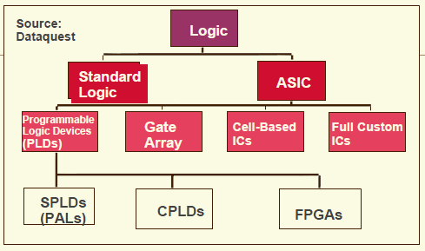
PLD Families
Common Resources
Logic Blocks (LB)
– Memory Look-Up Table
– AND-OR planes
– Simple gates
Input / Output Blocks (IOB)
– Bidirectional, latches, inverters,
– pullup/pulldowns
Interconnect or Routing
– Local, internal feedback, and global

Slide 4
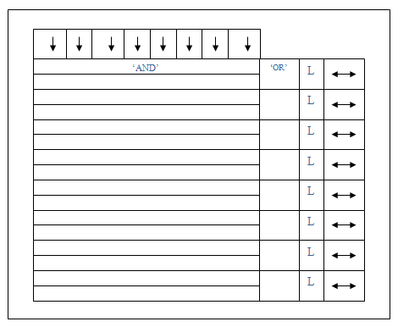
Simple Programmable Logic Devices (SPLD)
Figure 1: Simple Programmable Logic Devices Architecture

Slide 5
SPLD (cont.)
SPLD are the smallest and consequently the least-expensive form of programmable logic.
Programmable 'AND' array decodes the specific input pin combinations of interest and the programmable 'OR' arrays defines output for a few terms per logic cell.
A switch matrix selects which of the inputs will be connected to the AND inputs which are then connect to the OR matrix.
Signal routing can be changed by the logic equations.

Slide 6
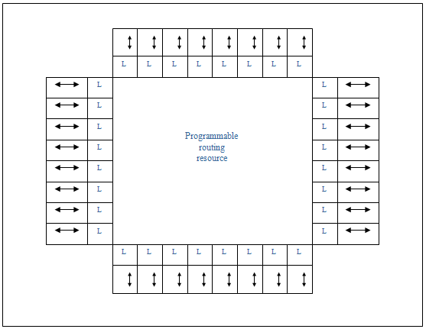
Complex Programmable Logic Devices (CPLD)
Figure 2: Complex Programmable Logic Devices Architecture

Slide 7
CPLD (cont.)
CPLD are similar to SPLD except that they are significantly higher capacity.
Figure 2 (CPLD) is equivalent to four of the devices in Figure 1 (SPLD) connected together.
The key feature of this architecture is the arrangement of logic cells on the periphery of a central shared routing resource.
CPLD are generally best for control-oriented designs, due in part to their fast pin-to-pin performance.

Slide 8
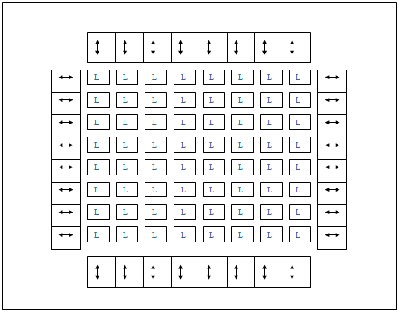
Field Programmable Gate Arrays (FPGA)
Figure 3: Field Programmable Gate Arrays (FPGA)

Slide 9
FPGA (cont.)
FPGA contain hundreds (or thousands) of configurable Logic Block (CLB).
One CLB is a rectangular area on the chip that contains a lookup table (LUT), a flip-flop and routing.
LUT are used to create a logic function such as AND, OR, XOR.
The flip-flop allows synchronization (based on a clock signal) and the routing is just a lot of interconnection wiring between the CLB which can be linked together to form complex logic implementations.
Array of logic blocks is surrounded by programmable I/O blocks and connected with programmable interconnection (Figure 3).

Slide 10
FPGA (cont.)
Most FPGAs do not provide 100% interconnection between their logic blocks because it would be prohibitively expensive.
Instead, sophisticated software places and routes the logic on the device almost the same as a Printed Circuit Board (PCB) auto router would place and route components.
FPGAs are typically programmed in languages like Verilog or VHDL using Electronic Device Automation (EDA) tools.

Slide 11
FPGA (cont.)
There are two primary classes of FPGA architectures:
coarse-grained and
fine-grained
Another difference in architectures is the underlying process technology used to manufacture the device. The common process technologies are:
PROM/EPROM/EEPROM/FLASH based
Anti-fuse based
SRAM based

Slide 12
FPGA architectures:
Coarse-grained Architecture
Coarse-grained being made up of bigger macro cells.
The macro cells often made up of flip-flops and Look up Tables (LUTs) which makes up the combinatorial logic functions.
In a majority of these architectures, four-input look-up table (think of it as a 16x1 ROM) implements the actual logic.
The larger logic block usually corresponds to improved performance.

Slide 13
FPGA architectures:
Fine-grained Architecture
Fine-grained made up of a sea of gates or transistors or small macro cells.
These devices are good at systolic functions and have some benefits for designs created by logic synthesis.

Slide 14
History of Semiconductor Technology
Vacuum tubes
Made amplification possible
But
Unreliable
Used too much power
Produced too much heat
Bell labs, AT&T
Try to solve vacuum tubes problems
Form a group – Sockley, Brattain, Bardeen

Slide 15
(Cont.)
Bill Sockley
Team leader
Theoretician
Designed “field-effect”’ - did not work
Develop junction (sandwich) transistor
Found Shockley Semiconductor (beginning of Silicon Valley
Walter Brattain
Experimental physicist
Built & run experiments

Slide 16
(Cont.)
John Bardeen
Theoretical physicist
Suggest experiment & interpret result
develop point contact resistor with Brattain
Fairchild Semiconductor
Formed by “traitorous eight” from Shockley Semiconductor
Intel Corporation
Bob Noyce and Gordon Moore (also from Shockley Semiconductor)
Sony
US company focus on military market in producing transistor product
Left door wide open for Japanese engineers
Masaru Ibuko and Akio Mirota – (founder of Sony)
Mass produced tiny transistorized radio

Slide 17
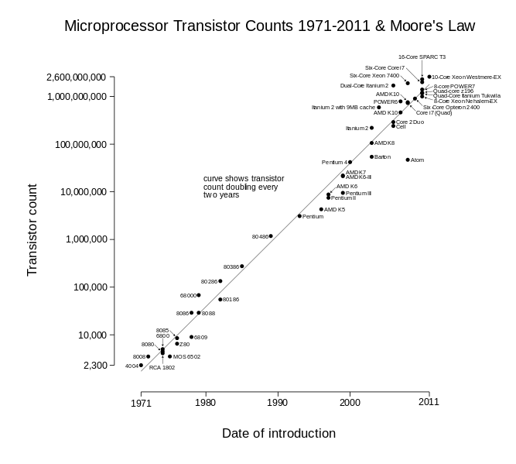
Transistor in Chip
https://en.wikipedia.org/wiki/Transistor_count

Slide 18
FPGA Process Technology
PROM/EPROM/EEPROM/FLASH based:
These technologies implementation are typically programmed out of circuit and can or cannot be reprogrammed.
PROM is one time programmable (OTP) device can only be programmed once. Once programmed, it cannot be reprogrammed.
EPROM cells are electrically programmed in a device programmer. Some EPROM-based devices are erasable using ultra-violet (UV) lights if they are in a windowed package. However, most EPROM is in low-cost plastic packaging for production. Plastic packages cannot be UV erased.

Slide 19
(Cont.)
An Electrically-Erasable-Programmable-Read-Only-Memory (EEPROM) memory cell is physically larger than an EPROM cell but offers the advantage of being erased electrically with no special UV erasers require. Plus, EEPROM devices can be erased, even in low-cost plastic packaging.
FLASH-erased (or bulk erased) electrically erasable programmable read-only memory. FLASH has the electrically erasable benefits of EEPROM but the small, economical cell size of EPROM technology.

Slide 20
FPGA Process Technology
Anti-fuse based:
Anti-fuse is a one-time programmable (OTP).
Fuses are permanently put in place.
The anti-part of anti-fuse comes from its programming method.
Instead of breaking a metal connection by passing current through it, a link is grown to make a connection.
Anti-fuses are either amorphous silicon or metal-to-metal connections.
The advantages of anti fuse are usually physically quite small and have low on resistance.
However, they require large programming transistors on the device and another obvious disadvantage is that it can not be reuse.

Slide 21
FPGA Process Technology
SRAM based :
SRAM cells are implemented as function generators to simulate combinatorial logic and also are used to control multiplexors and routing resources. These are by far the most popular process technology. This method is similar to the technology used in static RAM devices but with a few modifications. The RAM cells in a memory device are designed for fastest possible read/write performance. The RAM cells in a programmable device are usually designed for stability instead of read/write performance. Consequently, RAM cells in a programmable device have a low-impedance connect to VCC and ground to provide maximum stability over voltage fluctuations.
Because static memory is volatile (the contents disappear when the power is turned off), SRAM-based devices are "booted" after power-on. This makes them in-system programmable and re-programmable, even in real-time. As a result, SRAM-based FPGAs are common in reconfigure computing applications where the device's function is dynamically changed.

Slide 22
(Cont.)
The configuration process typically requires only a few hundred milliseconds at most. Most SRAM-based devices can boot themselves automatically at power-on much like a microprocessor. Furthermore, most SRAM-based devices are designed to work with either standard byte-wide PROMs or with sequential-access serial PROMs.

Slide 23
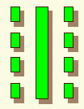
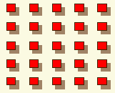
CPLDs and FPGAs
 | CPLD | FPGA
Architecture | PAL-like More Combinational | Gate array-like More Registers + RAM
Density | Low-to-medium 0.5-10K logic gates | Medium-to-high 1K to 500K system gates
Performance | Predictable timing Up to 200 MHz today | Application dependent Up to 135MHz today
Interconnect | “Crossbar” | Incremental

Slide 24
CPLD or FPGA?
CPLD | FPGA
Non-volatile • Wide fan-in • Fast counters, state machines • Combinational Logic • Small student projects lower level courses • Control Logic | SRAM reconfiguration • Excellent for computer architecture, DSP, registered designs • ASIC like design flow • Great for first year to graduate work • More common in schools • PROM required for non-volatile operation

Slide 25
The Advantages of FPGA
The FPGA is one of the fast growing components invented and have revolutionized the way many systems are designed. That’s why many designers and companies have chosen it. Some of FPGA advantages are listed below:
Low-cost
Fast-turnaround implementation alternative
Supported by CAD/EDA tools
High density
High speed
Programmable and versatile
Flexible
Reusability
Large amounts of logic gates, registers, RAM and routing resources
Quick time-to-market
SRAM FPGA provide the benefits of custom CMOS

Slide 26
FPGA Vendors
Actel
Altera
Atmel
Chip Express
Clear Logic
Cypress
DynaChip
Fast Analog Solutions Ltd
Gatefield
HammerCores
Lattice
Lucent Technologies
Military and Aerospace Applications of Programmable Devices and Technologies Conference (MAPLD) Sept. 26-28, 2000
Motorola
Orbit
QuickLogic
QuickTurn
Vantis
Xilinx

Slide 27
FPGA Customer Type
•Broadcast Communication
Satellite Links, CATV:scrambler&decoder...
•Consumer
Video Games, HDTV, Digital Audio Decoder…
•Industrial
Test&Measurement Equipment, Robotic, Motor/Motion Control…
•Data Communication
Multiplexer, Router, Data Compression, Modem, HUB...
•Telecommunication
ATM, ISDN Interface, SONET Interface, PBX...
•Military
Missile Guidance Avionics, Fire Control, Communication system...
•Computer
Memory Interface, DMA controller, Multi-Media, Co-processors...
•Peripherals
Disk Controller, Barcode Reader, Modem, Data Acquisition Cards...

Slide 28
Contributor
Example of two World leading FPGA contributor:
Xilinx
Altera – Intel FPGA

Slide 29
Xilinx
KEYWORDS:
Virtex FPGAs
XC4000X Series FPGAs
Spartan Series FPGAs
XC9500 Series CPLDs
Foundation/Alliance Software
Location San Jose, California
Comments: Xilinx is a leading innovator of complete programmable logic solutions, including advanced integrated circuits, software design tools, predefined system functions delivered as cores.

Slide 30

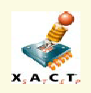
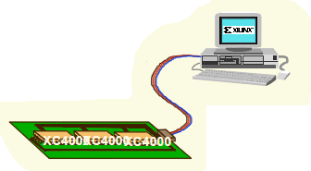
Design Flow (Xilinx)
Design Entry in schematic, ABEL, VHDL, and/or Verilog. Vendors include Synopsys,
Aldec (Xilinx Foundation), Mentor, Cadence, Viewlogic, and others
2. Implementation includes Placement &
Routing and bitstream generation using
Xilinx’s M1 Technology. Also, analyze timing,
view layout, and more.
2. Download directly to the Xilinx
hardware device(s) with
unlimited reconfigurations* !!

Slide 31
Altera
KEYWORDS:
max+PLUSII
FLEX
MAX
APEX
CPLD
Quartus
IP solutions
PCI solutions
Location San Jose, California
Comments: Altera is a manufacturer of high-performance, high-density programmable logic devices and associated computer-aided engineering (CAE) tools.

Slide 32
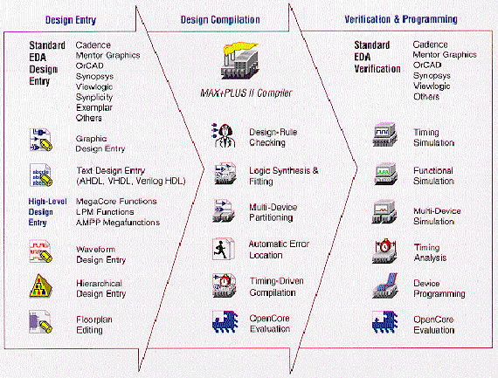
Design Flow (Altera)

Slide 33
Altera FPGAs Device
High-End FPGAs
Stratix V (E,GX, GS, GT)
Stratic IV (E, GX, GT)
Stratix III (L and E)
Stratix II (and GX)
Stratix (and GX)
Midrange FPGAs
Arria V (GX, GT, GZ, SX, ST)
Arria II (GX and GZ)
Arria GX
Low-Cost FPGAs
Cyclone V (E, GX, GT, SE, SX, ST)
Cyclone IV (E and GX)
Cyclone III (LS)
Cyclone II
Cyclone

Slide 34
Altera Cyclone FPGA Series
This FPGA Series provide market’s lowest cost, lowest power FPGAs and embedded with transceiver variant. Apart from that, ideal for high-volume and cost-sensitive application. It also offer up to 150,000 logic element (LEs) and consume up to 30% less total power.
The Cyclone FPGA series are categories as a low-cost FPGAs and compatible for:-
Broadcast
Consumer
Industrial
Wireless
Wireline
Education

